Slide 1

UNIT – IV Tools and Methods Used in Cybercrime
K. BALAKRISHNA
B.Tech., MBA., M.Tech., DID., (Ph.D)

Slide 2
4.1 INTRODUCTION
Different forms of attacks through which attackers target the computer systems are as follows:
1.Initial uncovering
Two steps are involved here:
• In the first step called as reconnaissance, the attacker gathers information about the target on the Internet websites.
• In the second step, the attacker finds the company’s internal network, such as, Internet domain, machine names and the company’s Internet Protocol (IP) address ranges to steal the data.
2.Network probe (investigation)
• At the network probe stage, the attacker scans the organization information through a <ping sweep= of the network IP addresses.
• And then a <port scanning= tool is used to discover exactly which services are running on the target system.
• At this point, the attacker has still not done anything that would be considered as an abnormal activity on the network or anything that can be classified as an intrusion.

Slide 3
4.1 INTRODUCTION
3. Crossing the line toward electronic crime (E-crime):
• Once the attackers are able to access a user account, then they will attempt further exploits to get an administrator or <root= access.
• Root access is a UNIX term and is associated with the system privileges required to run all services and access all files on the system (readers are expected to have a basic familiarity with Unix-based systems).
4. Grab the data:
• Now that the attacker has <captured the network,= he/she takes advantage of his/her position to steal confidential data.
5. Covering tracks:
• This is the last step in any cyberattack, which refers to the activities undertaken by the attacker to extend misuse of the system without being detected.
• The attacker can remain undetected for long periods.
• During this entire process, the attacker takes optimum care to hide his/her identity (ID) from the first step itself.

Slide 4
4.2 PROXY SERVERS AND ANONYMIZERS
Proxy server is a computer on a network which acts as an intermediary for connections with other computers on that network.
• The attacker first connects to a proxy server and establishes a connection with the target system through existing connection with proxy.
• This enables an attacker to surf on the Web anonymously and/or hide the attack.
• A client connects to the proxy server and requests some services (such as a file, webpage) available from a different server.
• The proxy server evaluates the request and provides the resource by establishing the connection to the respective server and/or requests the required service on behalf of the client.
• The proxy server evaluates the request and provides the resource by establishing the connection to the respective server and/or requests the required service on behalf of the client.
• Using a proxy server can allow an attacker to hide ID (i.e., become anonymous on the network).

Slide 5
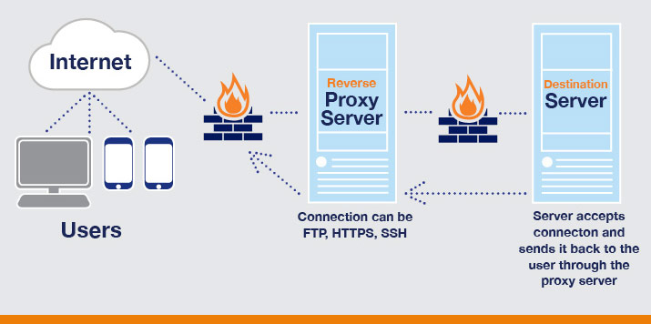
4.2 PROXY SERVERS AND ANONYMIZERS

Slide 6
4.2 PROXY SERVERS AND ANONYMIZERS
A proxy server has following purposes:
1. Keep the systems behind the curtain (mainly for security reasons).
2. Speed up access to a resource (through <caching=). It is usually used to cache the webpages from a web server.
3. Specialized proxy servers are used to filter unwanted content such as advertisements.
4. Proxy server can be used as IP address multiplexer to enable to connect number of computers on the Internet, whenever one has only one IP address
One of the advantages of a proxy server is that its cache memory can serve all users.
If one or more websites are requested frequently, may be by different users, it is likely to be in the proxy’s cache memory, which will improve user response time.
An anonymizer or an anonymous proxy is a tool that attempts to make activity on the Internet untraceable. It accesses the Internet on the user’s behalf, protecting personal information by hiding the source computer’s identifying information.
Anonymizers are services used to make Web surfing anonymous by utilizing a website that acts as a proxy server for the web client.

Slide 7
4.3 PHISHING
• <Phishing= refers to an attack using mail programs to deceive Internet users into disclosing confidential information that can be then exploited for illegal purposes.
• While checking electronic mail (E-Mail) one day a user finds a message from the bank threatening to close the bank account if he/she does not reply immediately.
• Although the message seems to be suspicious from the contents of the message, it is difficult to conclude that it is a fake/false E-Mail.
• This message and other such messages are examples of Phishing – in addition to stealing personal and financial data – and can infect systems with viruses and also a method of online ID theft in various cases.
• These messages look authentic and attempt to get users to reveal their personal information.
• It is believed that Phishing is an alternative spelling of <fishing,= as in <to fish for information.=
• The first documented use of the word <Phishing= was in 1996.

Slide 8
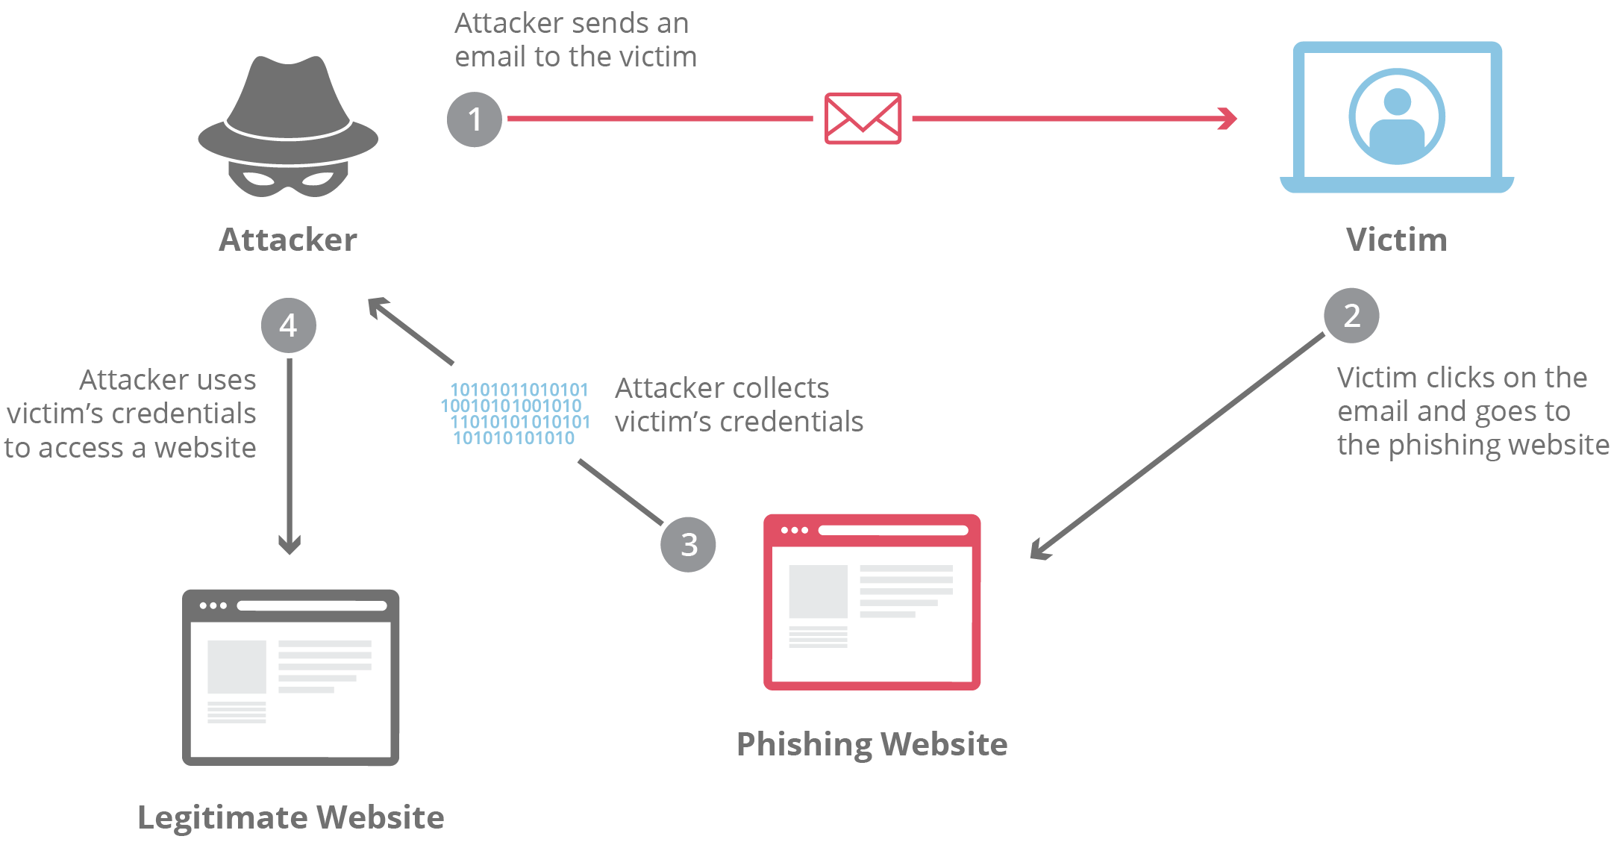
4.3 PHISHING

Slide 9
4.3 PHISHING
4.3.1 How Phishing Works?
Phishers work in the following ways:
1. Planning: Criminals, usually called as phishers, decide the target.
2. Setup: Once phishers know which business/business house to spoof and who their victims.
3. Attack: the phisher sends a phony message that appears to be from a reputable source.
4. Collection: Phishers record the information of victims entering into webpages or pop-up windows.
5. Identity theft and fraud: Phishers use the information that they have gathered to make illegal purchases or commit fraud.
Nowadays, more and more organizations/institutes provide greater online access for their customers and hence criminals are successfully using Phishing techniques to steal personal information and conduct ID theft at a global level.

Slide 10

4.4 PASSWORD CRACKING

Slide 11
4.4 PASSWORD CRACKING
• Password is like a key to get an entry into computerized systems like a lock.
• Password cracking is a process of recovering passwords from data that have been stored in or transmitted by a computer system.
• Usually, an attacker follows a common approach – repeatedly making guesses for the password.
The purpose of password cracking is as follows:
1. To recover a forgotten password.
2. As a preventive measure by system administrators to check for easily crackable passwords.
3. To gain unauthorized access to a system.
Manual password cracking is to attempt to logon with different passwords. The attacker follows the following steps:
1. Find a valid user account such as an Administrator or Guest;
2. create a list of possible passwords;
3. rank the passwords from high to low probability;
4. key-in each password;
5. try again until a successful password is found.

Slide 12
4.4 PASSWORD CRACKING
Passwords can be guessed sometimes with knowledge of the user’s personal information. Examples of guessable passwords include:
1. Blank (none);
2. the words like <password,= <passcode= and <admin=;
3. series of letters from the <QWERTY= keyboard, for example, qwerty, asdf or qwertyuiop;
4. user’s name or login name;
5. name of user’s friend/relative/pet;
6. user’s birthplace or date of birth, or a relative’s or a friend’s;
7. user’s vehicle number, office number, residence number or mobile number;
8. name of a celebrity who is considered to be an idol (e.g., actors, actress, spiritual gurus) by the user;
• An attacker can also create a script file (i.e., automated program) which will be executed to try each password in a list.
• This is still considered manual cracking, is time-consuming and not usually effective.

Slide 13
4.4 PASSWORD CRACKING
• Passwords are stored in a database and password verification process is established into the system when a user attempts to login or access a restricted resource.
• To ensure confidentiality of passwords, the password verification data is usually not stored in a clear text format.
• For example, one-way function (which may be either an encryption function or a cryptographic hash) is applied to the password, possibly in combination with other data, and the resulting value is stored.
•When a user attempts to login to the system by entering the password, the same function is applied to the entered value and the result is compared with the stored value. If they match, user gains the access;
The most commonly used hash functions can be computed rapidly and the attacker can test these hashes with the help of passwords cracking tools (see Table 4.3) to get the plain text password.
Password Cracking Tools: Default Password, Cain & Abel , John the Ripper, THC-Hydra , Aircrack-ng LophtCrack, AirSnort , Solar Winds , Pwdump , RainbowCrack , Brutus
this process is called authentication.

Slide 14
4.4 PASSWORD CRACKING
Password cracking attacks can be classified under three categories as follows:
1. Online attacks;
2. offline attacks;
3. non-electronic attacks (e.g., social engineering, shoulder surfing and dumpster diving).
4.4.1 Online Attacks
• An attacker can create a script file that will be executed to try each password in a list and when
matches, an attacker can gain the access to the system.
• The most popular online attack is man-in-the middle (MITM) attack, also termed as <bucket-brigade attack= or sometimes <Janus attack.=
• It is a form of active stealing in which the attacker establishes a connection between a victim and the server to which a victim is connected.
• When a victim client connects to the fraudulent server, the MITM server intercepts the call, hashes the password and passes the connection to the victim server (e.g., an attacker within reception range of an unencrypted Wi-Fi wireless access point can insert himself as a man-in- the-middle).

Slide 15
4.4 PASSWORD CRACKING
• This type of attack is used to obtain the passwords for E-Mail accounts on public websites such as Yahoo, Hotmail and Gmail and can also used to get the passwords for financial websites that would like to gain the access to banking websites.
4.4.2 Offline Attacks
• Mostly offline attacks are performed from a location other than the target (i.e., either a computer system or while on the network) where these passwords reside or are used.
• Offline attacks usually require physical access to the computer and copying the password file from the system onto removable media.
4.4.3Strong , Weak and Random Passwords
Weak passwords:
A weak password is one,which could be easily guessed,short,common and a system default password that could be easily found by executing a brite force attack and by using a subset of all possible passwords.

Slide 16
4.4 PASSWORD CRACKING
• The password contains less than eight characters
• The password is a word found in a dictionary (English or foreign)
• The password is a common usage word such as:
• Names of family, pets, friends, co-workers, fantasy characters, etc.
• Computer terms and names, commands, sites, companies, hardware, software.
• The words "<Company Name>", "sanjose", "sanfran" or any derivation.
• Birthdays and other personal information such as addresses and phone numbers.
• Word or number patterns like aaabbb, qwerty, zyxwvuts, 123321, etc.
• Any of the above spelled backwards.
• Any of the above preceded or followed by a digit (e.g., secret1,1secret )
Strong Passwords:
A strong password is long enough, random or otherwise difficult to guess-producible only by the user who chooses it
• Contain both upper and lower case characters (e.g., a-z, A-Z)

Slide 17
4.4 PASSWORD CRACKING
• Have digits and punctuation characters as well as letters e.g., 0-9, @#$%^&*()_+|~-=\`{}[]:";'<>?,./)
• Are at least eight alphanumeric characters long.
• Are not a word in any language, slang, dialect, jargon, etc.
• Are not based on personal information, names of family, etc.
• Passwords should never be written down or stored on-line.
• Try to create passwords that can be easily remembered.
• One way to do this is create a password based on a song title, affirmation, or other phrase.
• For example, the phrase might be: "This May Be One Way To Remember" and the password
could be: "TmB1w2R!" or "Tmb1W>r~" or some other variation.
Random passwords
Secure Password Generator
Password Length, Include Symbols ( e.g. @#$% ) , Include Numbers: ( e.g. 123456 ) , Include
Lowercase Characters: ( e.g. abcdefgh ) ,Include Uppercase Characters: ( e.g. ABCDEFGH ),

Slide 18
4.4 PASSWORD CRACKING
Exclude Similar Characters: ( e.g. i, l, 1, L, o, 0, O ) ,Exclude Ambiguous Characters: ( { } [ ] ( ) / \ ‘ " ` ~ , ; : . < > ) , Generate On The Client Side: ( do NOT send across the Internet ) , Auto-Select: ( select the password automatically ) , Save My Preference: ( save all the settings above for later use ) ,Load My Settings Anywhere: URL to load my settings on other computers quickly , Your New Password: Remember your password: Remember your password with the first letters of each word in this sentence.
To prevent your passwords from being hacked by social engineering, brute force or dictionary attack method, you should notice that:
1. Do not use the same password for multiple important accounts.
2. Use a password that has at least 16 characters, use at least one number, one uppercase letter, one lowercase letter and one special symbol.
3. Do not use the names of your families, friends or pets in your passwords.
4. Do not use postcodes, house numbers, phone numbers, birthdates, ID card numbers, social security numbers, and so on in your passwords.
5. Do not use any dictionary word in your passwords.

Slide 19
4.4 PASSWORD CRACKING
6. Do not use something that can be cloned( but you can't change ) as your passwords, such as your fingerprints.
7. Do not let your Web browsers( FireFox, Chrome, Safari, Opera, IE ) store your passwords, since all passwords saved in Web browsers can be revealed easily.
8. Do not log in to important accounts on the computers of others, or when connected to a public WiFi hotspot, Tor, free VPN or web proxy.
9. Do not send sensitive information online via HTTP or FTP connections, because messages in these connections can be sniffed with very little effort. You should use encrypted connections such as HTTPS and SFTP whenever possible.
10. It's recommended to change your passwords every 10 weeks.
11. Be careful when using online paste tools and screen capture tools, do not let them to upload your passwords to the cloud.
12. If there are important files on your computer, and it can be accessed by others, check if there are hardware keyloggers( e.g. wireless keyboard sniffer ), software keyloggers and hidden cameras when you feel it's necessary.

Slide 20
4.4 PASSWORD CRACKING
Password guidelines:
1.Passwords used for business E-Mail accounts, personal E-Mail accounts and banking/financial user accounts should be kept separate.
2. Passwords should be of minimum eight alphanumeric characters (common names or phrases should be phrased).
3.Passwords should be changed every 30/45 days.
4.Passwords should not be shared with relatives and/or friends.
5.Password used previously should not be used while renewing the password.
6. Passwords of personal E-Mail accounts and banking/financial user accounts should be changed from a secured system, within couple of days, if these E-Mail accounts has been accessed from public Internet facilities such as cybercafes/hotels/libraries.
7.Passwords should not be stored under mobile phones/PDAs, as these devices are also prone to cyberattacks.
8.In case E-Mail accounts/user accounts have been hacked, respective agencies/institutes should be contacted immediately.

Slide 21
4.5 Keyloggers and Spywares
• Keystroke logging, often called keylogging, is the practice of noting (or logging) the keys struck on a keyboard, typically in a covert manner so that the person using the keyboard is unaware that such actions are being monitored.
• Keystroke logger or keylogger is quicker and easier way of capturing the passwords and monitoring the victims’ IT savvy behavior. It can be classified as software keylogger and hardware keylogger.
4.5.1 Software Keyloggers
• Software keyloggers are software programs installed on the computer systems which usually are located between the OS and the keyboard hardware, and every keystroke is recorded.
• Software keyloggers are installed on a computer system by Trojans or viruses without the knowledge of the user.
• Cybercriminals always install such tools on the insecure computer systems available in public places (i.e., cybercafés, etc) and can obtain the required information about the victim very easily.
• A keylogger usually consists of two files that get installed in the same directory: a dynamic link library (DLL) file and an EXEcutable (EXE) file that installs the DLL file and triggers it to work. DLL does all the recording of keystrokes.

Slide 22
4.5 Keyloggers and Spywares
Some Important Keyloggers are as follows
All In One Keylogger | Stealth Keylogger | Perfect Keylogger
KGB Spy | Spy Buddy | Elite Keylogger
CyberSpy | Powered Keylogger
4.5.2 Hardware Keyloggers
• Hardware keyloggers are small hardware devices.
• These are connected to the PC and/or to the keyboard and save every keystroke into a file or in the memory of the hardware device.
• Cybercriminals install such devices on ATM machines to capture ATM Cards’ PINs.
• Each keypress on the keyboard of the ATM gets registered by these keyloggers.
• These keyloggers look like an integrated part of such systems; hence, bank customers are unaware of their presence.

Slide 23

4.5 Keyloggers and Spywares

Slide 24
4.5 Keyloggers and Spywares
4.5.3 Antikeylogger
Antikeylogger is a tool that can detect the keylogger installed on the computer system and also can remove the tool. (Visit http://www.anti-keyloggers.com for more information)
Advantages of using antikeylogger are as follows:
1. Firewalls cannot detect the installations of keyloggers on the systems; hence, antikeyloggers can detect installations of keylogger.
2. This software does not require regular updates of signature bases to work effectively such as other antivirus and antispy programs; if not updated, it does not serve the purpose, which makes the users at risk.
3. Prevents Internet banking frauds. Passwords can be easily gained with the help of installing keyloggers.
4. It prevents ID theft (we will discuss it more in Chapter 5).
5. It secures E-Mail and instant messaging/chatting.

Slide 25
4.5 Keyloggers and Spywares
4.5.3 Spywares
• Spyware is a type of malware (i.e., malicious software) that is installed on computers which collects information about users without their knowledge.
• The presence of Spyware is typically hidden from the user; it is secretly installed on the user’s personal computer.
• Sometimes, however, Spywares such as keyloggers are installed by the owner of a shared, corporate or public computer on purpose to secretly monitor other users. Some Important Spywares are as follows
Spy. | Spector Pro. | Spector Pro.
eBlaster. | Remotespy . | Stealth Recorder Pro.
Stealth Website Logger. | Flexispy. | Wiretap Professional.
PC PhoneHome. | SpyArsenal Print Monitor Pro.

Slide 26

4.5 Keyloggers and Spywares

Slide 27
Box 4.3 | Malwares
Malware, short for malicious software, is a software designed to infiltrate a computer system without the owner’s informed consent. The expression is a general term used by computer professionals to mean a variety of forms of hostile, intrusive or annoying software or program code. Malware can be classified as follows:
1. Viruses and worms: These are known as infectious malware. They spread from one computer system to another with a particular behavior.
2. Trojan Horses: A Trojan Horse,[14] Trojan for short, is a term used to describe malware that appears, to the user, to perform a desirable function but, in fact, facilitates unauthorized access to the user’s computer system
3. Rootkits: Rootkits is a software system that consists of one or more programs designed to obscure the fact that a system has been compromised.
4. Backdoors: Backdoor[16] in a computer system (or cryptosystem or algorithm) is a method of bypassing normal authentication, securing remote access to a computer, obtaining access to plain text and so on while attempting to remain undetected.
5. Spyware:Spyware is associated with specific unauthorized software that can collect information concerning the user or his activity without obtaining the user’s permission.

Slide 28
6. Botnets:A botnet is a logical collection of Internet-connected devices, such as computers, smartphones or Internet of things (IoT) devices whose security have been breached and control ceded to a third party.
7. Keystroke loggers:A keylogger, short for keystroke logger, is a type of surveillance technology used to monitor and record each keystroke typed on a keyboard.

Slide 29
4.6 Virus and Worms
• Computer virus is a program that can <infect= legitimate programs by modifying them to include a possibly <evolved= copy of itself.
• Viruses spread themselves, without the knowledge or permission of the users, to potentially large numbers of programs on many machines.
• A computer virus passes from computer to computer in a similar manner as a biological virus passes from person to person.
• Viruses may also contain malicious instructions that may cause damage or annoyance; the combination of possibly Malicious Code with the ability to spread is what makes viruses a considerable concern.
• Viruses can often spread without any readily visible symptoms.
• A virus can start on event-driven effects (e.g., triggered after a specific number of executions), time-driven effects (e.g., triggered on a specific date, such as Friday the 13th) or can occur at random.

Slide 30
4.6 Virus and Worms
Viruses can take some typical actions:
1. Display a message to prompt an action which may set of the virus;
2. delete files inside the system into which viruses enter;
3. scramble data on a hard disk;
4. cause erratic screen behavior;
5. halt the system (PC);
6. just replicate themselves to propagate further harm.
• Computer virus has the ability to copy itself and infect the system.
• The term virus is also commonly but erroneously used to refer to other types of malware, Adware and Spyware programs that do not have reproductive ability.
• A true virus can only spread from one system to another (in some form of executable code) when its host is taken to the target computer; for instance, when a user sent it over the Internet or a network, or carried it on a removable media such as CD, DVD or USB drives.
• Viruses can increase their chances of spreading to other systems by infecting files on a network file system or a file system that is accessed by another system.

Slide 31
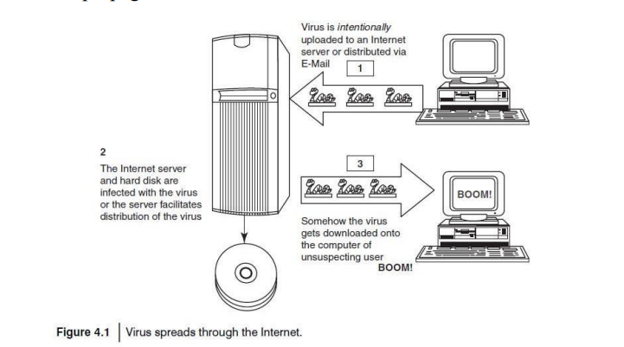
4.6 Virus and Worms

Slide 32
4.6 Virus and Worms
• Malware includes computer viruses, worms, Trojans, most Rootkits, Spyware, dishonest Adware, crimeware and other malicious and unwanted software as well as true viruses.
• Viruses are sometimes confused with computer worms and Trojan Horses, which are technically different (see Table 4.7 to understand the difference between computer virus and worm).
• A worm spreads itself automatically to other computers through networks by exploiting security vulnerabilities, whereas a Trojan is a code/program that appears to be harmless but hides malicious functions.
• Worms and Trojans, such as viruses, may harm the system’s data or performance.
• Some viruses and other malware have noticeable symptoms that enable computer user to take necessary corrective actions, but many viruses are surreptitious or simply do nothing for user’s to take note of them.
• Some viruses do nothing beyond reproducing themselves.

Slide 33
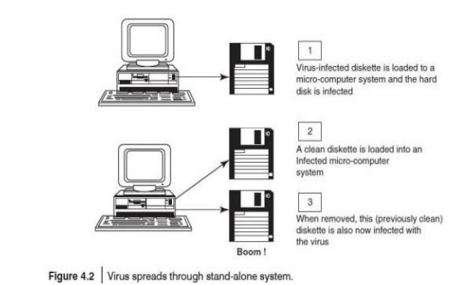
4.6 Virus and Worms

Slide 34
4.6 Virus and Worms
4.6.1 Types of Viruses
1.Boot sector viruses: It infects the storage media on which OS is stored (e.g., hard drives) and which is used to start the computer system.
2.Program viruses: These viruses become active when the program file (usually with extensions .bin, .com,.exe, .ovl, .drv) is executed.
3. Multipartite viruses: It is a hybrid of a boot sector and program viruses. It infects program files along with the boot record when the infected program is active.
4. Stealth viruses: It hides itself and so detecting this type of virus is very difficult. It can hiding itself such a way that antivirus software also cannot detect it. Example for Stealth virus is <Brain Virus=.
5. Polymorphic viruses: It acts like a <chameleon= that changes its virus signature (i.e., binary pattern) every time it spreads through the system (i.e., multiplies and infects a new file). Hence, it is always difficult to detect polymorphic virus with the help of an antivirus program.

Slide 35
4.6 Virus and Worms
6. Macro viruses: Many applications, such as Microsoft Word and Microsoft Excel, support lOMoAR cPSD|25196479 MACROs (i.e., macrolanguages). These macros are programmed as a macro embedded in a document. Once macrovirus gets onto a victim’s computer then every document he/she produces will become infected. 7. Active X and Java Control: All the web browsers have settings about Active X and Java Controls.
World’s worst worm attacks.
Conficker INF/AutoRun Win32 PSW Win32/Agent
Win32/FlyStudio Win32/Pacex.Gen Win32/Qhost WMA/ TrojanDownloader
The world’s worst virus and worm attacks!!!
Morris Worm | ILOVEYOU | Nimda | Jerusalem
Code Red | Melissa | MSBlast
Sobig | Storm Worm | Michelangelo

Slide 36
4.7 Trojan Horses and Backdoors
• Trojan Horse is a program in which malicious or harmful code is contained inside apparently harmless programming or data in such a way that it can get control and cause harm, for example, ruining the file allocation table on the hard disk.
• A Trojan Horse may get widely redistributed as part of a computer virus.
• The term Trojan Horse comes from Greek mythology about the Trojan War.
• Like Spyware and Adware, Trojans can get into the system in a number of ways, including from a web browser, via E-Mail.
• It is possible that one could be forced to reformat USB flash drive or other portable device to eliminate infection and avoid transferring it to other machines.
• Unlike viruses or worms, Trojans do not replicate themselves but they can be equally destructive.
• On the surface, Trojans appear benign and harmless, but once the infected code is executed, Trojans kick in and perform malicious functions to harm the computer system without the user’s knowledge.
• For example, waterfalls.scr is a waterfall screen saver as originally claimed by the author; however, it can be associated with malware and become a Trojan to unload hidden programs and allow unauthorized access to the user’s PC.

Slide 37
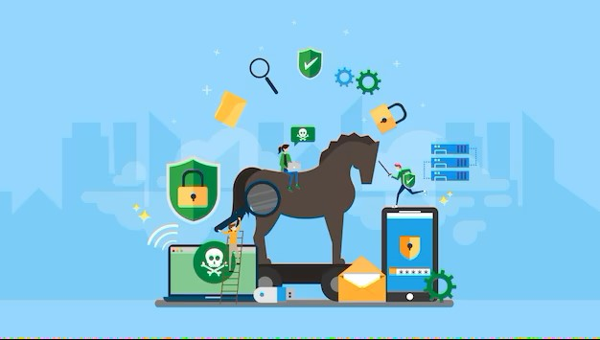
4.7 Trojan Horses and Backdoors

Slide 38
4.7 Trojan Horses and Backdoors
Some typical examples of threats by Trojans are as follows:
1. They erase, overwrite or corrupt data on a computer.
2.They help to spread other malware such as viruses (by a dropper Trojan).
3. They deactivate or interfere with antivirus and firewall programs.
4. They allow remote access to your computer (by a remote access Trojan).
5. They upload and download files without your knowledge.
6. They gather E-Mail addresses and use them for Spam.
7. They log keystrokes to steal information such as passwords and credit card numbers.
8. They copy fake links to false websites, display porno sites, play sounds/videos and display images.
9. They slow down, restart or shutdown the system.
10. They reinstall themselves after being disabled.
11. They disable the task manager.
12. They disable the control panel.

Slide 39
4.7 Trojan Horses and Backdoors
4.7.1 Backdoor
• A backdoor is a means of access to a computer program that bypasses security mechanisms. A programmer may sometimes install a backdoor so that the program can be accessed for troubleshooting or other purposes.
• However, attackers often use backdoors that they detect or install themselves as part of an exploit.
• In some cases, a worm is designed to take advantage of a backdoor created by an earlier attack.
• A backdoor works in background and hides from the user.
• It is very similar to a virus and, therefore, is quite difficult to detect and completely disable.
•A backdoor is one of the most dangerous parasite, as it allows a malicious person to perform any possible action on a compromised system.

Slide 40
4.7 Trojan Horses and Backdoors
Following are some functions of backdoor:
1. It allows an attacker to create, delete, rename, copy or edit any file, execute various commands; change any system settings; alter the Windows registry; run, control and terminate applications; install arbitrary software and parasites.
2. It allows an attacker to control computer hardware devices, modify related settings, shutdown or restart a computer without asking for user permission.
3. It steals sensitive personal information, valuable documents, passwords, login names, ID details; logs user activity and tracks web browsing habits.
4. It records keystrokes that a user types on a computer’s keyboard and captures screenshots.
5. It sends all gathered data to a predefined E-Mail address, uploads it to a predetermined FTP server or transfers it through a background Internet connection to a remote host.
6. It infects files, corrupts installed applications and damages the entire system.
Following are a few examples of backdoor Trojans:
1. Back Orifice 2. Bifrost: 3. SAP backdoors 4. Onapsis Bizploit
Follow the following steps to protect your systems from Trojan Horses and backdoors:
1. Stay away from suspect websites/weblinks
2. Surf on the Web cautiously
3. Install antivirus/Trojan remover software

Slide 41
4.8 Steganography
• Steganography is the practice of concealing (hiding) a file, message, image, or video within another file, message, image, or video. The word steganography combines the Greek words steganos , meaning "covered, concealed, or protected", and graphein meaning "writing".
• It is a method that attempts to hide the existence of a message or communication.
• Steganography is always misunderstood with cryptography
• The different names for steganography are data hiding, information hiding and digital watermarking.
• Digital watermarking is the process of possibly irreversibly embedding information into a digital signal.
• Steganography can be used to make a digital watermark to detect illegal copying of digital images. Thus, it aids confidentiality and integrity of the data.
• The Digital signal may be, for example, audio, pictures or video.
• If the signal is copied then the information is also carried in the copy. • In other words, when steganography is used to place a hidden .

Slide 42

4.8 Steganography

Slide 43
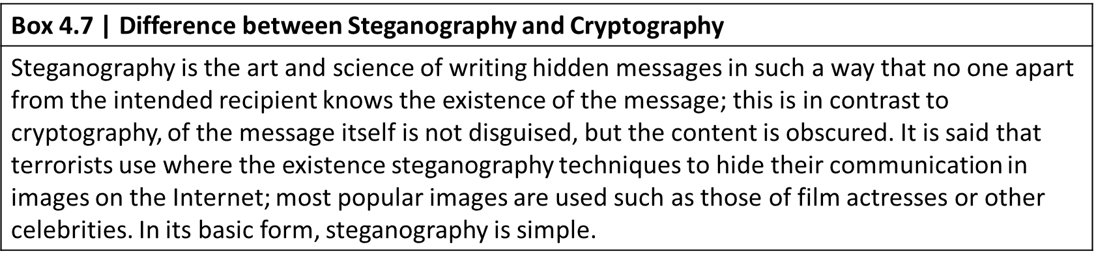
4.8 Steganography
4.8.1 Steganalysis
• Steganalysis is the art and science of detecting messages that are hidden in images, audio/video files using steganography.
• The goal of steganalysis is to identify suspected packages and to determine whether or not they have a payload encoded into them, and if possible recover it.
• Automated tools are used to detect such steganographed data/information hidden in the image and audio and/or video files.

Slide 44
4.9 DoS and DDoS Attacks
• A denial-of-service attack (DoS attack) or distributed denial-of-service attack (DDoS attack) is an attempt to make a computer resource (i.e., information systems) unavailable to its intended users.
4.9.1 DoS Attacks
• In this type of criminal act, the attacker floods the bandwidth of the victim’s network or fills his E-Mail box with Spam mail depriving him of the services he is entitled to access or provide.
• The attackers typically target sites or services hosted on high-profile web servers such as banks, credit card payment gateways, mobile phone networks and even root name servers
• Buffer overflow technique is employed to commit such kind of criminal attack known as Spoofing.
• The term IP address Spoofing refers to the creation of IP packets with a forged (spoofed) source IP address with the purpose of concealing the ID of the sender or impersonating another computing system
• A packet is a formatted unit of data carried by a packet mode computer network.

Slide 45
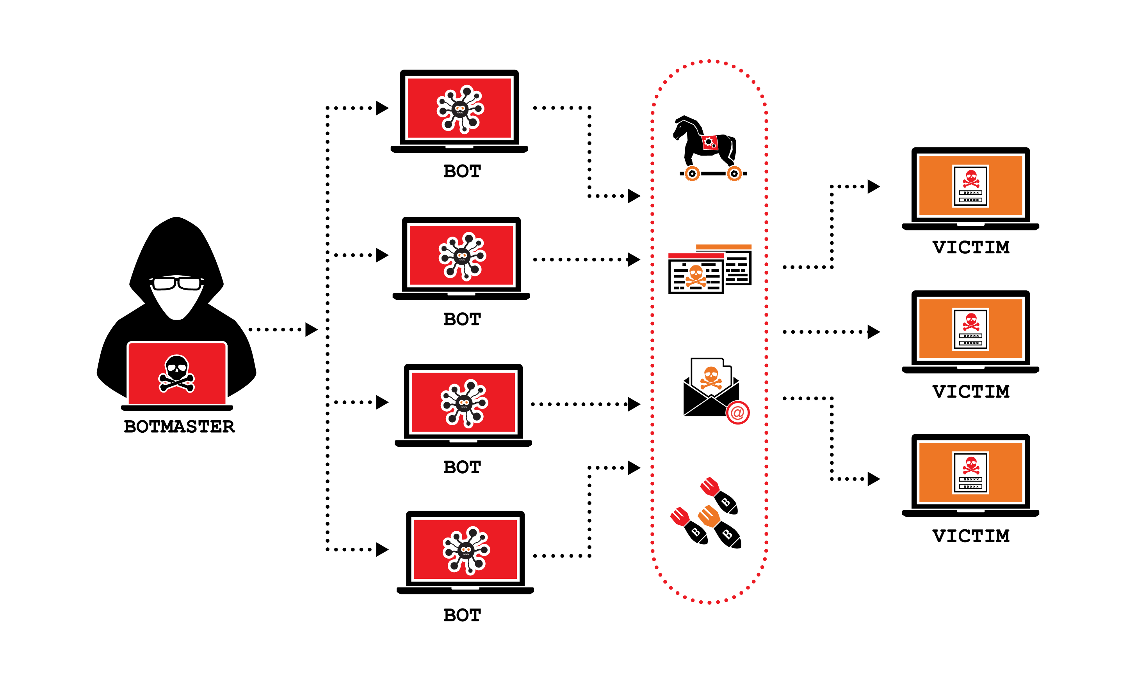
4.9 DoS and DDoS Attacks

Slide 46
4.9 DoS and DDoS Attacks
. • The attacker spoofs the IP address and floods the network of the victim with repeated requests.
• As the IP address is fake, the victim machine keeps waiting for response from the attacker’s machine for each request.
• This consumes the bandwidth of the network which then fails to serve the legitimate requests and ultimately breaks down.
• The United States Computer Emergency Response Team defines symptoms of DoS attacks to include:
1.Unusually slow network performance (opening fi les or accessing websites);
2. unavailability of a particular website;
3. inability to access any website;
4. dramatic increase in the number of Spam E-Mails received (this type of DoS attack is termed as an E-Mail bomb).

Slide 47
4.9 DoS and DDoS Attacks
The goal of DoS is not to gain unauthorized access to systems or data, but to prevent intended users (i.e., legitimate users) of a service from using it.
A DoS attack may do the following:
1. Flood a network with traffic, thereby preventing legitimate network traffic.
2. Disrupt connections between two systems, thereby preventing access to a service.
3. Prevent a particular individual from accessing a service.
4. Disrupt service to a specific system or person.
4.9.2 Classification of DoS Attacks
1.Bandwidth attacks: Loading any website takes certain time. Loading means complete webpage appearing on the screen and system is awaiting user’s input.
2 Logic attacks: These kind of attacks can exploit vulnerabilities in network software such as web server or TCP/IP stack.
3 Protocol attacks: Protocols here are rules that are to be followed to send data over network.
4 Unintentional DoS attack : This is a scenario where a website ends up denied not due to a attack by a single individual or group of individuals, but simply due to a sudden enormous spike in popularity.

Slide 48
4.9 DoS and DDoS Attacks
4.9.3 Types or Levels of DoS Attacks
There are several types or levels of DoS attacks as follows:
1. Flood attack: This is the earliest form of DoS attack and is also known as ping food. It is based on an attacker simply sending the victim overwhelming number of ping packets, usually by using the <ping= command, which result into more traffic than the victim can handle.
2. Ping of death attack: The ping of death attack sends oversized Internet Control Message Protocol (ICMP) packets, and it is one of the core protocols of the IP Suite. It is mainly used by networked computers’ OSs to send error messages indicating (e.g., that a requested service is not available or that a host or router could not be reached) datagrams (encapsulated in IP packets) to the victim.
3. SYN attack: It is also termed as TCP SYN Flooding. In the TCP, handshaking of network connections is done with SYN and ACK messages.
▪ An attacker initiates a TCP connection to the server with an SYN.
▪ The server replies with an SYN-ACK.
▪ The client then does not send back an ACK, causing the server to allocate memory for the
pending connection and wait.
▪ This fills up the buffer space for SYN messages on the target system, preventing other systems on the network from communicating with the target system.

Slide 49
4.9 DoS and DDoS Attacks
4. Teardrop attack: The teardrop attack is an attack where fragmented packets are forged to overlap each other when the receiving host tries to reassemble them. IP’s packet fragmentation algorithm is used to send corrupted packets to confuse the victim and may hang the system. This attack can crash various OSs due to a bug in their TCP/IP fragmentation reassembly code.
5. Smurf attack: This is a type of DoS attack that floods a target system via spoofed broadcast ping messages. This attack consists of a host sending an echo request (ping) to a network broadcast address.
6. Nuke: Nuke is an old DoS attack against computer networks consisting of fragmented or invalid packets sent to the target.
4.9.4 Tools Used to Launch DoS Attack
1 Jolt2 : The vulnerability allows remote attackers to cause a DoS attack against Windows-based machines – the attack causes the target machine to consume of the CPU time on processing of illegal packets.
2 Nemesy : This program generates random packets of spoofed source IP to enable the attacker to launch DoS attack.

Slide 50
4.9 DoS and DDoS Attacks
3 Targa : It is a program that can be used to run eight diff erent DoS attacks. Th e attacker has the option to launch either individual attacks or try all the attacks until one is successful.
4 Crazy Pinger : This tool could send large packets of ICMP(Internet Control Message Protocol) to a remote target network.
5 SomeTrouble: It is a remote flooder and bomber. It is developed in Delphi.
4.9.5 DDoS Attacks
• In a DDoS attack, an attacker may use your computer to attack another computer.
• By taking advantage of security vulnerabilities or weaknesses, an attacker could take control of your computer.
• He/she could then force your computer to send huge amounts of data to a website or send Spam to particular E-Mail addresses.
• The attack is <distributed= because the attacker is using multiple computers, including yours, to launch the DoS attack.
• A DDoS attack is a distributed DoS wherein a large number of zombie systems are synchronized to attack a particular system.

Slide 51
4.9 DoS and DDoS Attacks
• The zombie systems are called <secondary victims= and the main target is called <primary victim.=
• Malware can carry DDoS attack mechanisms – one of the better-known examples of this is MyDoom.
• Botnet is the popular medium to launch DoS/DDoS attacks.
• Attackers can also break into systems using automated tools that exploit flaws in programs that listen for connections from remote hosts.
4.9.6 How to Protect from DoS/DDoS Attacks
Computer Emergency Response Team Coordination Center (CERT/CC) offers many preventive measures from being a victim of DoS attack.
1.Implement router filters. This will lessen your exposure to certain DoS attacks.
2. If such filters are available for your system, install patches to guard against TCP SYN flooding.
3. Disable any unused or inessential network service.
4. Enable quota systems on your OS if they are available.

Slide 52
4.9 DoS and DDoS Attacks
5. Observe your system’s performance and establish baselines for ordinary activity.
6. Routinely examine your physical security with regard to your current needs.
7. Use Tripwire or a similar tool to detect changes in configuration information or other files.
8. Invest in and maintain <hot spares= – machines that can be placed into service quickly if a similar machine is disabled.
9. Invest in redundant and fault-tolerant network configurations.
10. Establish and maintain regular backup schedules
11. Establish and maintain appropriate password policies

Slide 53
4.10 SQL Injection
• Structured Query Language (SQL) is a database computer language designed for managing data in relational database management systems (RDBMS).
• SQL injection is a code injection technique that exploits a security vulnerability occurring in the database layer of an application.
• SQL injection attacks are also known as SQL insertion attacks.
• Attackers target the SQL servers – common database servers used by many organizations to store confidential data.
• The prime objective behind SQL injection attack is to obtain the information while accessing a database table that may contain personal information such as credit card numbers, social security numbers or passwords.
• During an SQL injection attack, Malicious Code is inserted into a web form field or the website’s code.
• For example, when a user logs in with username and password, an SQL query is sent to the database to check if a user has valid name and password.
• With SQL injection, it is possible for an attacker to send crafted username and/or password field that will change the SQL query.

Slide 54
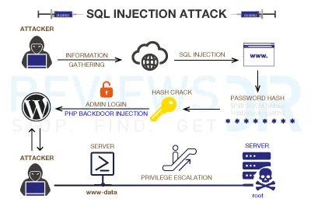
4.10 SQL Injection

Slide 55
4.10 SQL Injection
4.10.1 Steps for SQL Injection Attack
Following are some steps for SQL injection attack:
1. The attacker looks for the webpages that allow submitting data, that is, login page, search page, feedback, etc. The attacker also looks for the webpages that display the HTML commands such as POST or GET by checking the site’s source code.
2. To check the source code of any website, right click on the webpage and click on <view source= – source code is displayed in the notepad. The attacker checks the source code of the HTML, and look for <FORM= tag in the HTML code.
Everything between the <FORM> and </FORM> have potential parameters that might be useful to find the vulnerabilities.
<FORM action=Search/search.asp method=post>
<input type=hidden name=A value=C>
</FORM>
3. The attacker inputs a single quote under the text box provided on the webpage to accept the username and password. This checks whether the user-input variable is interpreted literally by the server. If the response is an error message such as use <a= = <a= then the website is found to be susceptible to an SQL injection attack.

Slide 56
4.10 SQL Injection
4. The attacker uses SQL commands such as SELECT statement command to retrieve data from the database or INSERT statement to add information to the database.
Here are few examples of variable field text the attacker uses on a webpage to test for SQL vulnerabilities:
1. Blah’ or 1=1--
2. Login:blah’ or 1=1--
3. Password::blah’ or 1=1--
4. http://search/index.asp?id=blah’ or 1=1—
Similar SQL commands may allow bypassing of a login and may return many rows in a table or even an entire database table because the SQL server is interpreting the terms literally. The double dashes near the end of the command tell SQL to ignore the rest of the command as a comment.
Blind SQL Injection
• Blind SQL injection is used when a web application is vulnerable to an SQL injection but the results of the injection are not visible to the attacker.
• The page with the vulnerability may not be the one that displays data; however, it will display differently depending on the results of a logical statement injected into the legitimate SQL statement called for that page.

Slide 57
4.10 SQL Injection
• This type of attack can become time-intensive because a new statement must be crafted for each bit recovered.
• There are several tools that can automate these attacks once the location of the vulnerability and the target information have been established.
4.10.2 How to Prevent SQL Injection Attacks
SQL injection attacks occur due to poor website administration and coding. The following steps can be taken to prevent SQL injection.
1. Input validation
• Replace all single quotes to two single quotes.
• Sanitize the input: User input needs to be checked and cleaned of any characters or strings that could possibly be used maliciously. For example, character sequences such as ; , --, select, insert and xp_ can be used to perform an SQL injection attack.
• Numeric values should be checked while accepting a query string value. Function – IsNumeric() for Active Server Pages (ASP) should be used to check these numeric values.
• Keep all text boxes and form fields as short as possible to limit the length of user input.

Slide 58
4.10 SQL Injection
2. Modify error reports: SQL errors should not be displayed to outside users
3. Other preventions:
• The default system accounts for SQL server 2000 should never be used.
• Isolate database server and web server.
• Buffer overflow, or buffer overrun, is an anomaly where a process stores data in a buffer outside the memory the programmer has set aside for it.
• This may result unreliable program behavior, including memory access errors, incorrect results, program termination (a crash) or a breach of system security.
• Buffer overflows can be triggered by inputs that are designed to execute code or alter the way the program operates.
• They are, thus, the basis of many software vulnerabilities and can be maliciously exploited. Bounds checking can prevent buffer overflows.
• Programming languages commonly associated with buffer overflows include C and C++, which provide no built-in protection against accessing or overwriting data in any part of memory and do not automatically check that data written to an array

Slide 59
4.11 Buffer Overflow
• Buffer overflow occurs when a program or process tries to store more data in a buffer (temporary
data storage area) than it was intended to hold.
• Although it may occur accidentally through programming error, buffer overflow is an increasingly
common type of security attack on data integrity.
• The knowledge of C, C++ or any other high-level computer language (i.e., assembly language) is
essential to understand buffer overflow.
For example, int
main () { int
buffer[10];
buffer[20] = 10;
}
• This C program is a valid program and every compiler can compile it without any errors.
• However, the program attempts to write beyond the allocated memory for the buffer, which might result in an unexpected behavior.

Slide 60
4.11 Buffer Overflow
4.11.1 Types of Buffer Overflow
Stack-Based Buffer Overflow
Stack buffer overflow occurs when a program writes to a memory address on the program’s call stack outside the intended data structure – usually a fixed length buffer. Here are the characteristics of stackbased programming:
1.<Stack= is a memory space in which automatic variables (and often function parameters) are allocated.
2. Function parameters are allocated on the stack and are not automatically initialized by the system, so they usually have garbage in them until they are initialized.
3. Once a function has completed its cycle, the reference to the variable in the stack is removed.
The attacker may exploit stack-based buffer overflows to manipulate the program in various ways by overwriting:
1. A local variable that is near the buffer in memory on the stack to change the behavior of the program that may benefit the attacker.
2. Function parameters are allocated on the stack and are not automatically initialized by the system, so they usually have garbage in them until they are initialized.

Slide 61
4.11 Buffer Overflow
3. Once a function has completed its cycle, the reference to the variable in the stack is removed.
The attacker may exploit stack-based buffer overflows to manipulate the program in various ways by overwriting:
1. A local variable that is near the buffer in memory on the stack to change the behavior of the program that may benefit the attacker.
2. The return address in a stack frame. Once the function returns, execution will resume at the return address as specified by the attacker, usually a user input-filled buffer.
3. A function pointer, or exception handler, which is subsequently executed.
The factors that contribute to overcome the exploits are
1. Null bytes in addresses;
2. Variability in the location of shell code;
3. Differences between environments.
A shell code is a small piece of code used as a payload in the exploitation of software vulnerability.
It is called <shell code= because it starts with command shell from which the attacker can control the compromised machine.

Slide 62
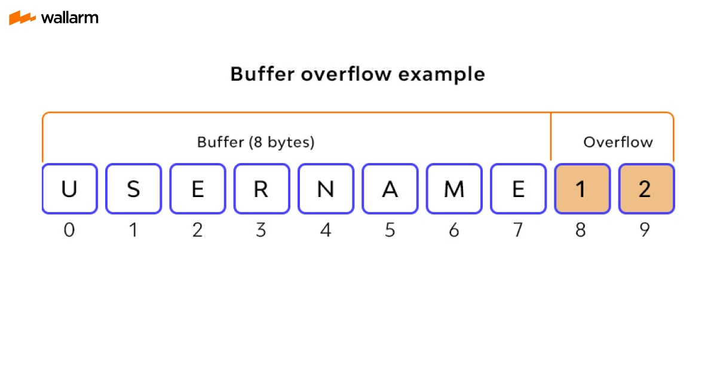
4.11 Buffer Overflow

Slide 63
4.11 Buffer Overflow
NOPs
NOP or NOOP (short form of no operation) is an assembly language instruction/ command that effectively does nothing at all.
Heap Buffer Overflow
Heap buffer overflow occurs in the heap data area and may be introduced accidentally by an application programmer, or it may result from a deliberate exploit. The characteristics of stack- based and heap-based programming are as follows:
1. <Heap= is a <free store= that is a memory space, where dynamic objects are allocated.
2. The heap is the memory space that is dynamically allocated new(), malloc() and calloc() functions; it is different from the memory space allocated for stack and code.
3. Dynamically created variables (i.e., declared variables) are created on the heap before the execution program is initialized to zero.
Memory on the heap is dynamically allocated by the application at run-time and normally contains program data. Exploitation is performed by corrupting this data in specific ways to cause the application to overwrite internal structures such as linked list pointers.

Slide 64
4.11 Buffer Overflow
4.11.2 How to Minimize Buffer Overflow
Although it is difficult to prevent all possible attacks, the following methods will definitely help to minimize such attacks:
1.Assessment of secure code manually: Buffer overflow occurs when a program or process tries to store more data in a buffer than it was intended to hold. Developers should be educated about minimizing the use of functions like strcpy(), strcat(), sprintf() and vsprintf() in C Language.
2. Disable stack execution: Malicious Code causes input argument to the program, and it resides in the stack and not in the code segment. Any code that attempts to execute any other code residing in the stack will cause a segmentation violation.
3. Compiler tools: Over the years, compilers have become more and more aggressive in optimizations and the checks they perform. Various compiler tools already off er warnings on the use of unsafe constructs such as gets(), strcpy(), etc. Developers should be educated to restructure the programming code if such warnings are displayed.
4. Dynamic run-time checks: In this scheme, an application has restricted access to prevent attacks. This method primarily relies on the safety code being preloaded before an application is executed. This preloaded component can either provide safer versions of the standard unsafe functions or it can ensure that return addresses are not overwritten. One example of such a tool is libsafe. The libsafe library provides a way to secure calls to these functions, even if the function is not available.

Slide 65
4.12 Attacks on Wireless Networks
• Wireless technologies have become increasingly popular in day-to-day business and personal lives.
• Hand-held devices such as the PDAs allow individuals to access calendars, E-Mail addresses, phone number lists and the Internet.
• Wireless networks extend the range of traditional wired networks by using radio waves to transmit data to wireless-enabled devices such as laptops and PDAs.
• Wireless networks are generally composed of two basic elements:
(a) access points (APs) and
(b) other wireless-enabled devices, such as laptops radio transmitters and receivers to communicate or <connect= with each other (see Fig. 4.6).
• APs are connected through physical wiring to a conventional network, and they broadcast signals with which a wireless device can connect.
• Wireless access to networks has become very common by now in India – for organizations and for individuals.

Slide 66
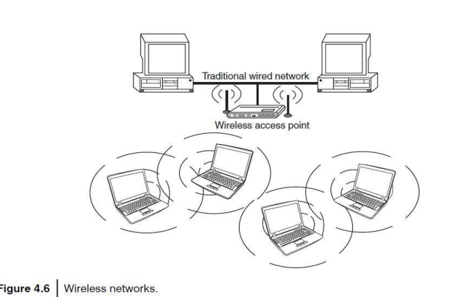
4.12 Attacks on Wireless Networks

Slide 67
4.12 Attacks on Wireless Networks
The following are different types of <mobile workers=:
1. Tethered/remote worker: This is considered to be an employee who generally remains at a single point of work, but is remote to the central company systems.
2. Roaming user: This is either an employee who works in an environment (e.g., warehousing, shop floor, etc.) or in multiple areas (e.g., meeting rooms).
3. Nomad: This category covers employees requiring solutions in semi-tethered (connected) environments where modem use frequently.
4. Road warrior: This is the ultimate mobile user and spends little time in the office;
Important components of wireless network:
1. 802.11 networking standards: Institute of Electrical and Electronics Engineers (IEEE)-
802.11 is a family of standards for wireless local area network (WLAN), stating the specifications and/or requirements for computer communication.
2. Access points: It is also termed as AP. It is a hardware device and/or software that act as a central transmitter and receiver of WLAN radio signals. Users of wireless device, such as laptop/PDAs, get connected with these APs, which in turn get connected with the wired LAN. An AP acts as a communication hub for users to connect with the wired LAN.

Slide 68
4.12 Attacks on Wireless Networks
3. Wi-Fi hotspots: A hotspot is a site that offers the Internet access by using Wi-Fi technology over a WLAN. Hotspots are found in public areas (such as coffee shops, public libraries, hotels and restaurants) and are commonly offered facility throughout much of North America and Europe.
• Free Wi-Fi hotspots: Wireless Internet service is offered in public areas, free of cost and that to without any authentication.
• Commercial hotspots: The users are redirected to authentication and online payment to avail the wireless Internet service in public areas.
4. Service Set IDentifier (SSID): It is the name of 802.11i WLAN and all wireless devices on a WLAN must use the same SSID to communicate with each other. While setting up WLAN, the user (or WLAN administrator) sets the SSID, which can be up to 32 characters long so that only the users who knew the SSID will be able to connect the WLAN. It is always advised to turn OFF the broadcast of the SSID.
5. Wired equivalence privacy (WEP): Wireless transmission is susceptible to eavesdropping and to provide confidentiality, WEP was introduced as part of the original 802.11i Protocol in 1997. It is always termed as deprecated security algorithm for IEEE 802.11i WLANs. SSID along with WEP delivers fair amount of secured wireless network.
6. Wi-Fi protected access (WPA and WPA2): WPA was introduced as an interim standard to replace WEP to improve upon the security features of WEP. WPA2 provides a stronger encryption mechanism through Advanced Encryption Standard (AES), which is a requirement for some corporate and government agencies.

Slide 69
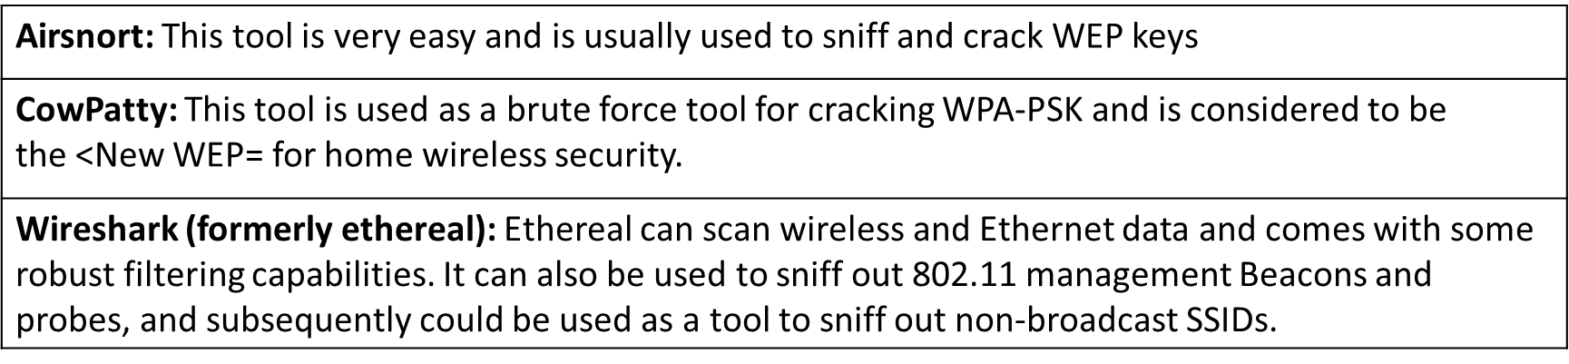
4.12 Attacks on Wireless Networks
7. Media access control (MAC): It is a unique identifier of each node (i.e., each network interfaces) of the network and it is assigned by the manufacturer of a network interface card (NIC) stored in its hardware. MAC address filtering allows only the devices with specific MAC addresses to access the network.
Tools used for hacking wireless networks
NetStumbler: This tool is based on Windows OS and easily identifies wireless signals being broadcast within range.
Kismet: This tool detects and displays SSIDs that are not being broadcast which 0is very critical in finding wireless networks.

Slide 70
4.12 Attacks on Wireless Networks
4.12.1 Traditional Techniques of Attacks on Wireless Networks
In security breaches, penetration of a wireless network through unauthorized access is termed as wireless cracking. There are various methods that demand high level of technological skill and knowledge, and availability of numerous software tools made it less sophisticated with minimal technological skill to crack WLANs.
1. Sniffing: The attacker usually installs the sniffers remotely on the victim’s system and conducts activities such as
• Passive scanning of wireless network;
• detection of SSID;
• colleting the MAC address;
• collecting the frames to crack WEP.
2. Spoofing: The attacker often launches an attack on a wireless network by simply creating a new network with a stronger wireless signal and a copied SSID in the same area as a original network.

Slide 71
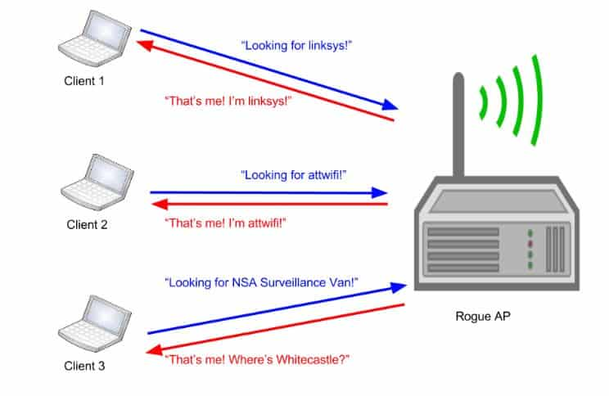
4.12 Attacks on Wireless Networks

Slide 72
4.12 Attacks on Wireless Networks
Different types of Spoofing are as follows.
• MAC address Spoofing
• IP Spoofing:
• Frame Spoofing:
3. Denial of service (DoS): We have explained this attack in detail in UNIT-2.
4. Man-in-the-middle attack (MITM): It refers to the scenario wherein an attacker on host A inserts A between all communications – between hosts X and Y without knowledge of X and Y.All messages sent by X do reach Y but through A and vice versa. The objective behind this attack is to merely observe the communication or modify it before sending it out.
5. Encryption cracking: It is always advised that the first step to protect wireless networks is to use WPA encryption. The attackers always devise new tools and techniques to deconstruct the older encryption technology, which is quite easy for attackers due to continuous research in this field.
Hence, the second step is to use a long and highly randomized encryption key; this is very important. It is a little pain to remember long random encryption; however, at the same time these keys are much harder to crack.

Slide 73
4.12 Attacks on Wireless Networks
4.12.2 How to Secure the Wireless Networks
Nowadays, security features of Wi-Fi networking products are not that time-consuming and nonintuitive; however, they are still ignored, especially, by home users. Although following summarized steps will help to improve and strengthen the security of wireless network, see Table
4.19 to know the available tools to monitor and protect the wireless networks:
1. Change the default settings of all the equipments/components of wireless network (e.g., IP address/user IDs/administrator passwords, etc.).
2. Enable WPA/WEP encryption.
3. Change the default SSID. 4. Enable MAC address filtering.
5. Disable remote login.
6. Disable SSID broadcast.
7. Disable the features that are not used in the AP (e.g., printing/music support).
8. Avoid providing the network a name which can be easily identified (e.g., My_Home_Wifi ).
9. Connect only to secured wireless network (i.e., do not autoconnect to open Wi-Fi hotspots).
10. Upgrade router’s firmware periodically.

Slide 74
4.12 Attacks on Wireless Networks
11. Assign static IP addresses to devices.
12. Enable firewalls on each computer and the router.
13. Position the router or AP safely.
14. Turn off the network during extended periods when not in use.
15. Periodic and regular monitor wireless network security.

